Slide 1
Foundations of Modern Software Systems
Module-3: Compute
Instructor: Piyush Goel
N.M.A.M. Institute of Technology

Slide 2
Module-3:Compute, Specialised Application Processes (SAP)

Slide 3
Specialised Application Processes (SAP)
Specific purpose for internet systems.
Web-Servers (HTTP/HTTPS)
Email Servers (SMTP)
File Servers (FTP)
Interesting Designs and interplay of Tasks.
Maximise Throughput, and Performance.
Concurrency Constructs underpin the design.

Slide 4
SAP:Web-Servers

Slide 5
SAP:Web-Servers
Web-Servers implement the HTTP(s) protocols to serve web-requests.
Web-Requests Types
Static - Same for all users
Dynamic - Vary across the users.
Static Requests are don’t require too much computation.
Javascript files, images, html, textual content.
Dynamic Request typically require data-loading from the databases, and caches.

Slide 6
Live Examples

Slide 7
SAP:Web-Servers
Features Supported by Web-Servers
Serving Static and Dynamic Content
HTTP(s) Support: Various Versions
Virtual Hosting
Authorisation
Rewrite Engine
Logging

Slide 8
SAP:Web-Servers: HTTP
Hyper-Text Transfer Protocol (HTTP)
The Hypertext Transfer Protocol (HTTP) is the foundation of the World Wide Web, and is used to load webpages using hypertext links. HTTP is an application layer protocol designed to transfer information between networked devices and runs on top of other layers of the network protocol stack. A typical flow over HTTP involves a client machine making a request to a server, which then sends a response message.
HTTP 1.0 is almost 30 years old.
Components
Headers
Body
Request URL
Method
Status Code

Slide 9
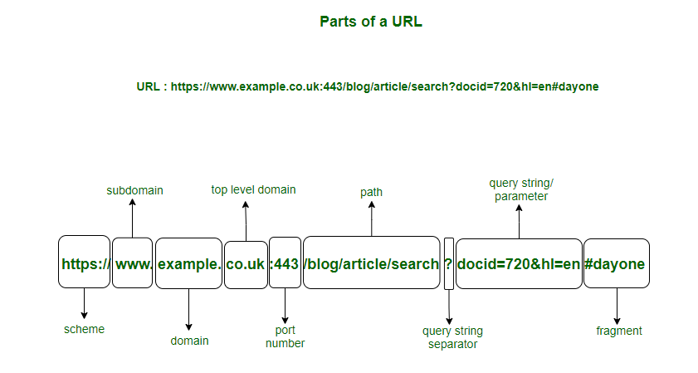
SAP:Web-Servers: HTTP

Slide 10
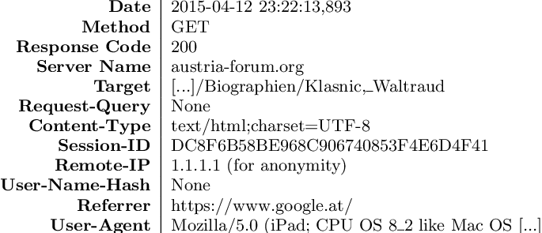
SAP:Web-Servers
Log Formats
127.0.0.1 user-identifier frank [10/Oct/2000:13:55:36 -0700] "GET /apache_pb.gif HTTP/1.0" 200 2326

Slide 11
SAP:Web-Servers
Two types of Server Architectures
Thread per request
Event Loop Driven

Slide 12
SAP:Web-Servers
Thread per request
Thread allocated to every request.
Requests are independent.
Block on the I/O.
#Threads can overwhelm the system

Slide 13
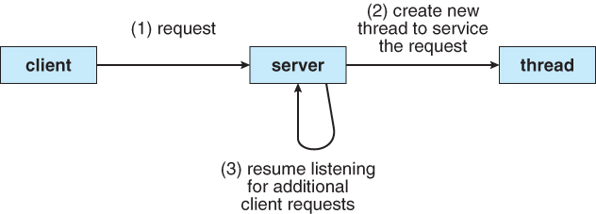
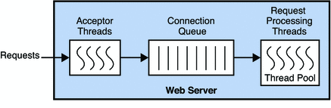
SAP:Web-Servers: Thread Per Request

Slide 14
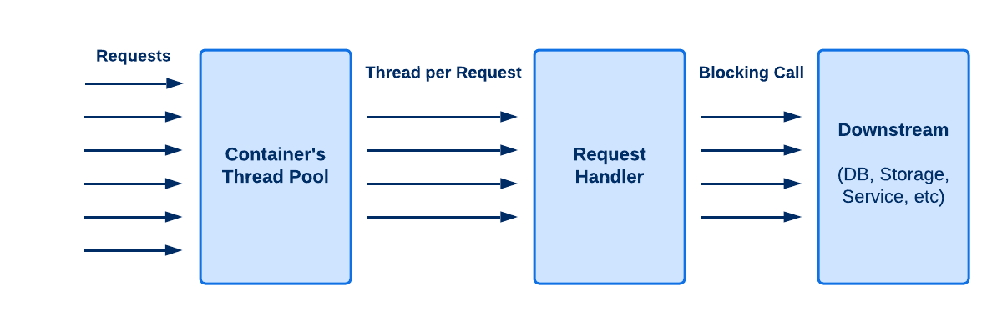
SAP:Web-Servers: Thread Per Request

Slide 15
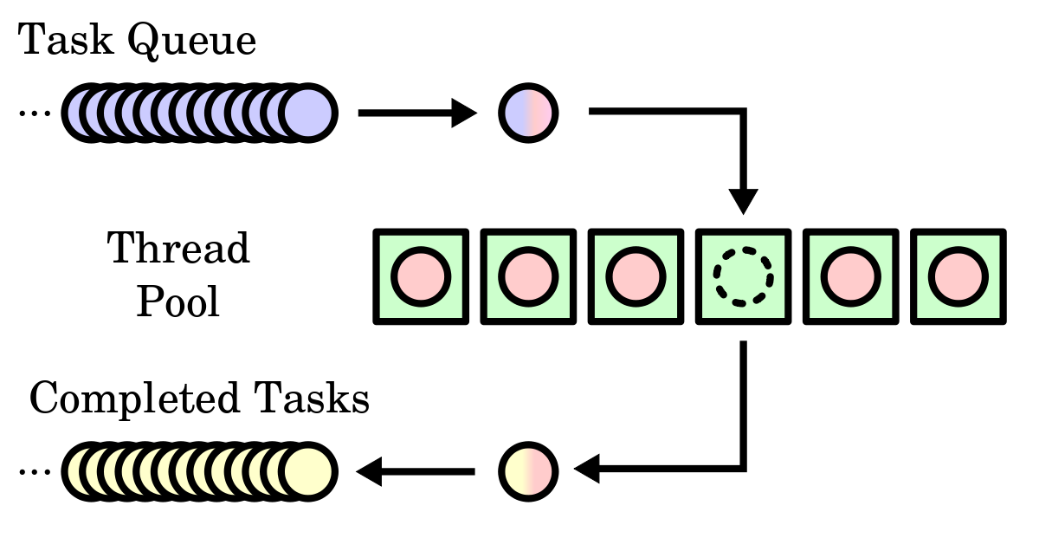
SAP:Web-Servers: ThreadPool

Slide 16
SAP:Web-Servers
Event Loop Driven
Have a main Event-Loop listening on events (Network Connection, File Events, I/O Events, etc)
ThreadPool of OS for executing IO. Logic executes in the Main Event Loop Thread.
I/O is decoupled from the Main Execution Thread.
Gives better performance on the CPU.
Programs are complex, and hard to reason with.

Slide 17
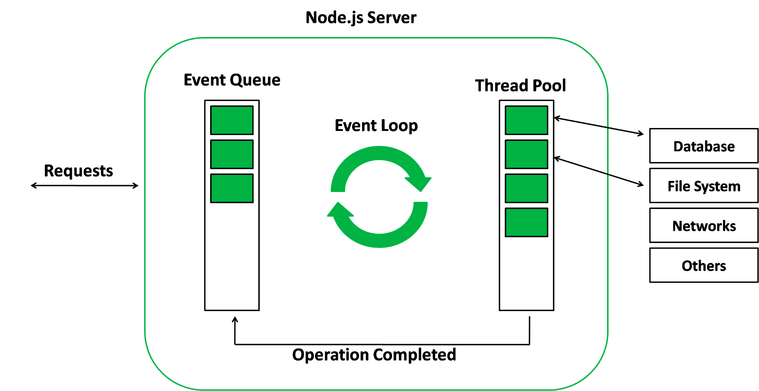
SAP:Web-Servers: Event Loop Server

Slide 18
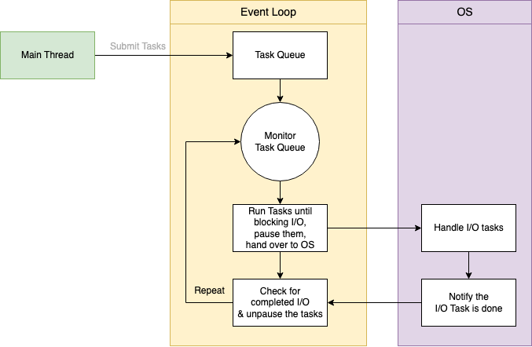
SAP:Web-Servers: Event Loop Server

Slide 19
SAP:Web-Servers: Event Loop Server
https://www.youtube.com/shorts/v6sI1tidSw8

Slide 20
SAP:Email Servers

Slide 21
SAP:Email Servers
Email Servers are designed to work with the SMTP (Simple Mail Transfer Protocol)
SMTP was designed to exchange emails.
Almost 40 years old.
An Email Message is similar to a Postmail.

Slide 22
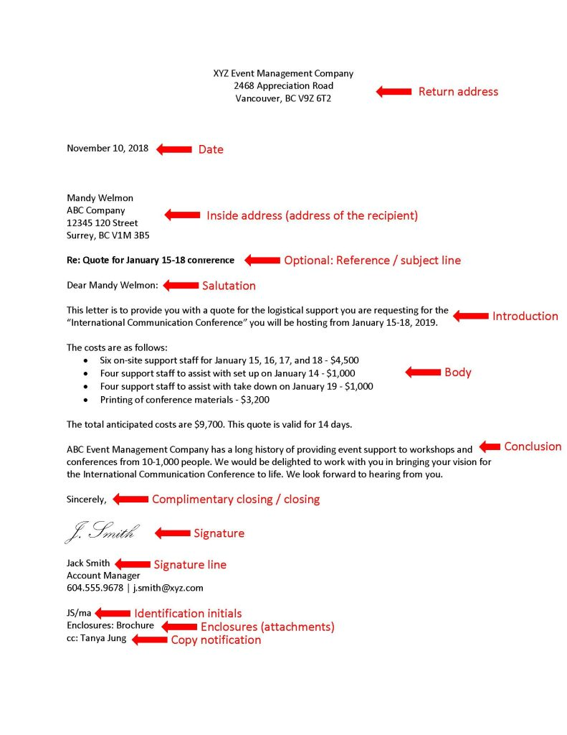
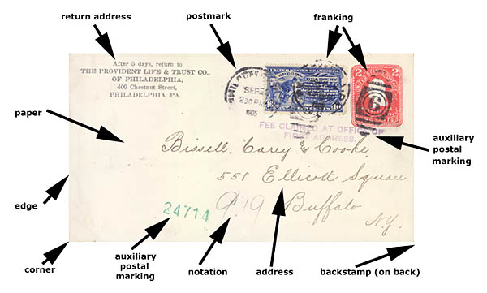
SAP:Email Servers

Slide 23
SAP:Emails: Live Example

Slide 24
SAP:Emails: Live Example: Base64 Encoding

Slide 25
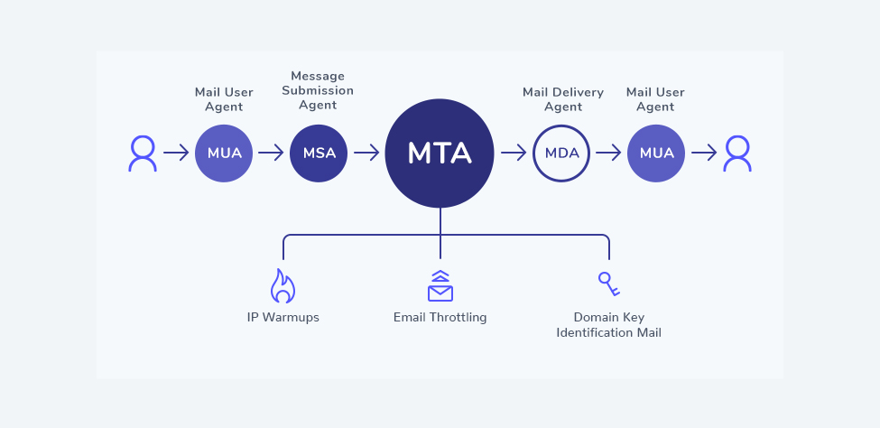
Email Transfer Flow

Slide 26
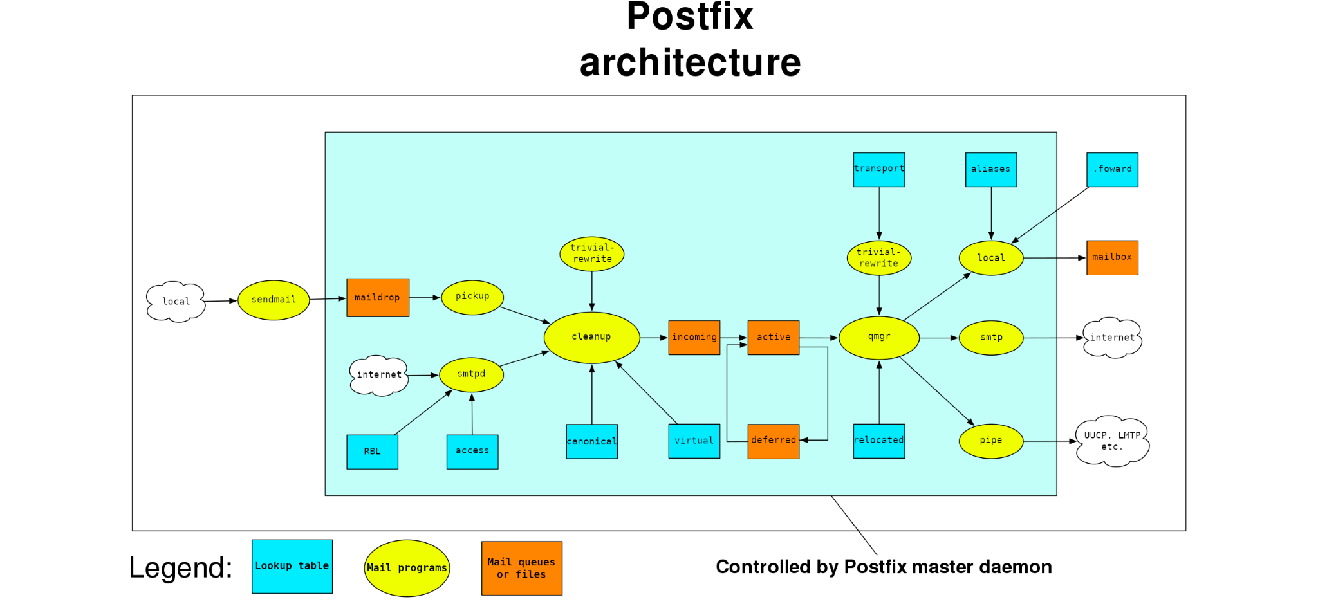

Slide 27
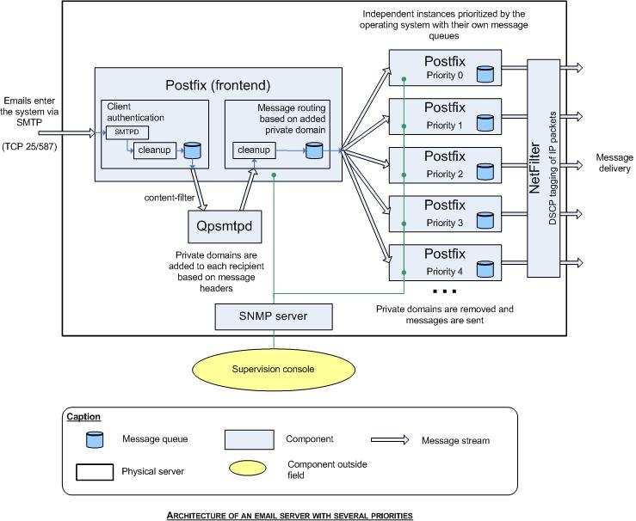
Architecture of Postfix
A popular Open-Source Email Agent.

Slide 28
SAP:Common Problems
Balancing I/O Bound Process and CPU Bound Processes.
Ensuring sufficient Threads are available to manage load.
Maintaining Task Level Isolation.
Keeping a Low Memory Footprint.
Most application Programs are multi-tasked, and rely on concurrency constructs to synchronise work.

